Slide 1
2rd Grade
Computer Science Dept/ College of Education for Pure Sciences
Special Topics: Microprocessor & Assembly Language
Lecture 5
Instructor: Ghazwan Abdulnabi Al-Ali
University of Basrah, Iraq

Slide 2
Logic Instruction
AND
OR
Input2 | Input2 | AND
0 | 0 | 0
0 | 1 | 0
1 | 0 | 0
1 | 1 | 1
Input2 | Input2 | OR
0 | 0 | 0
0 | 1 | 1
1 | 0 | 1
1 | 1 | 1

Slide 3
Logic Instruction
XOR
NOT
Input1 | Input2 | XOR
0 | 0 | 0
0 | 1 | 1
1 | 0 | 1
1 | 1 | 0
Input | NOT
0 | 1
1 | 0

Slide 4
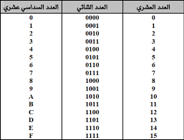
Example
  AND
  Mov al, 2F h
  Mov bl, 4C h
  And al,bl
  Result al=0C h
  al=00101111
  bl=01001100
  00001100
  OR
  Mov al, EA h
  Mov bl, D3 h
  OR al,bl
  Result al=FB h
  al=11101010
  bl=11010011
  11111011

Slide 5
Example
  XOR
  Mov al, 2c h
  Mov bl, 4f h
  XOR al,bl
  Result al=63 h
  al=00101100
  bl=01001111
  01100011
  NOT
  Mov al, EA h
  NOT al
  Result al=15 h
  al=11101010
  00010101

Slide 6
Shifting
Shifting
  SHL: this instruction shifts the operand n steps to the left, where n value is put in CL register.
  MOV CL,n
  MOV Reg, value
  SHL Reg, CL
  Example 1/
    MOV CL, 3
    MOV AH, c3
    SHL AH,CL
    AH=18
1 | 1 | 0 | 0 | 0 | 0 | 1 | 1
0 | 0 | 0 | 1 | 1 | 0 | 0 | 0 | 0 | 1 | 1
يهمل

Slide 7
Shifting
Shifting
  SHR: this instruction shifts the operand n steps to the right, where n value is put in CL register.
  MOV CL,n
  MOV Reg, value
  SHR Reg, CL
  Example 2/
    MOV CL, 4
    MOV AH, 51
    SHR AH,CL
    AH=10
0 | 1 | 0 | 0 | 0 | 0 | 0 | 1
0 | 1 | 0 | 0 | 0 | 0 | 0 | 1 | 0 | 0 | 0 | 0
يهمل

Slide 8

Rotation
Rotation
  ROL:- this instruction rotate the operand n steps to the left where CL contain the value of n
  MOV CL,n
  MOV Reg, value
  ROL Reg, CL
  Example 1/
    MOV CL, 3
    MOV AH, C3 h
    ROL AH,CL
    AH=1E h
1 | 1 | 0 | 0 | 0 | 0 | 1 | 1
0 | 0 | 0 | 1 | 1 | 1 | 1 | 0

Slide 9

Rotation
Rotation
  ROR:- this instruction rotate the operand n steps to the Right where CL contain the value of n
  MOV CL,n
  MOV Reg, value
  ROR Reg, CL
  Example 2/
    MOV CL, 3
    MOV AH, c3 h
    ROR AH, CL
    AH= 78 h
1 | 1 | 0 | 0 | 0 | 0 | 1 | 1
0 | 1 | 1 | 1 | 1 | 0 | 0 | 0

Slide 10
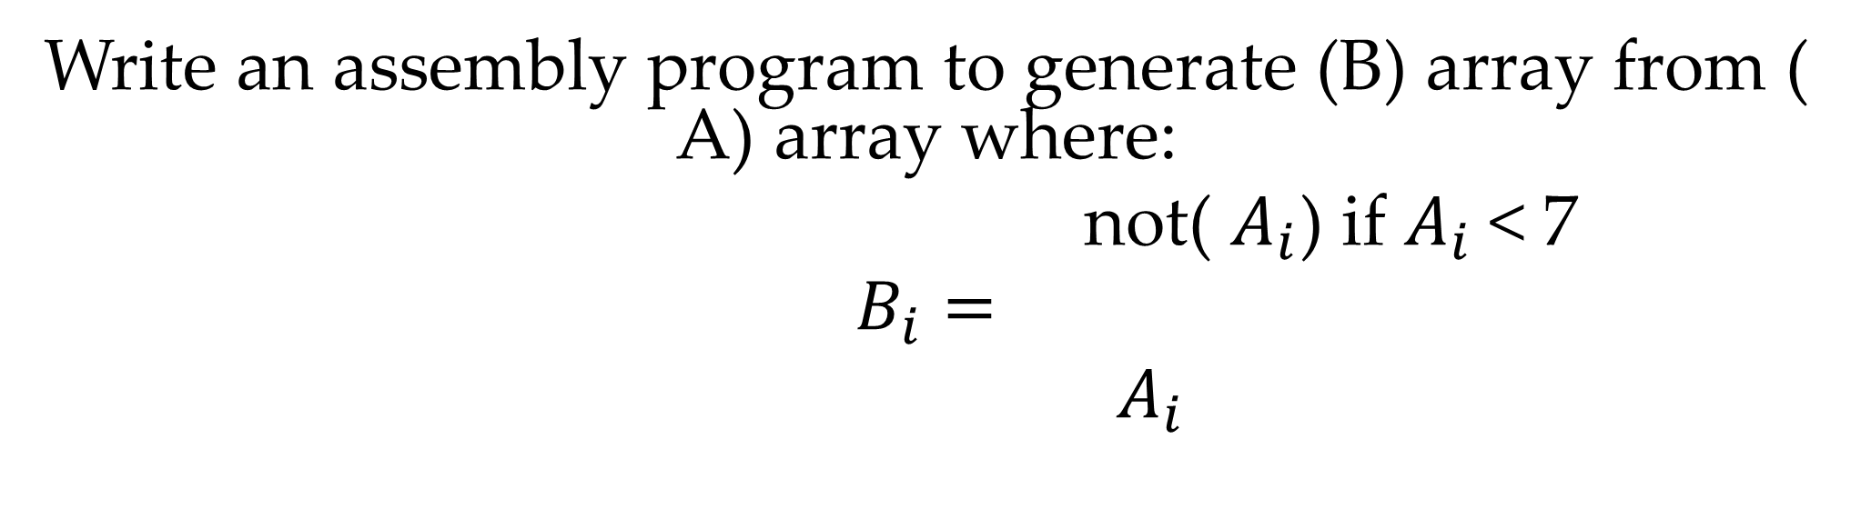
H.W 1
Write an assembly program to generate (B) array from ( A) array where:
not( $A_{i}$) if $A_{i}$< 7
$$B_{i}=$$
$A_{i}$

Slide 11
Solution
ORG 100H
JMP start
a db 3,10,6,0,7
b db ?,?,?,?,?
start: lea si , a
lea di ,b
mov cl,0
rep1: mov bl,[si]
cmp bl,7
jl if1
mov [di],bl
jmp cout1
if1:not bl
mov [di],bl
cout1:inc si
inc di
inc cl
cmp cl,5
jl rep1
03h, 0Ah, 06h, 00h, 07h
0FCh, 0Ah, 0F9h, 0FFh, 07h

Slide 12
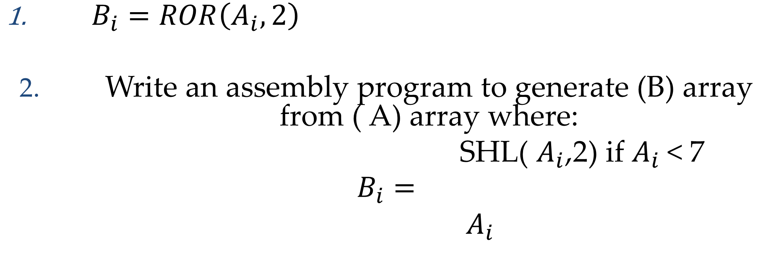
H.W 1
$B_{i}=ROR\left(A_{i},2\right)$
Write an assembly program to generate (B) array from ( A) array where:
SHL( $A_{i}$,2) if $A_{i}$< 7
$$B_{i}=$$
$A_{i}$

Slide 13
Thank You

